Slide 1
Was the Opium War of 1840-42 a Just war?
Peter Ward Fay
Group 1
Laura Ong, Zwe Wint Naing, Wu Jiayue, Monica Saravana, Surabhi Athalye

Slide 2
Why call it the “Opium War”
It was definitely a ‘war’: “ships and regiments went out to China, swept bays and rivers, occupied towns… and desisted from these enterprises only when the Chinese government agreed to negotiate a settlement of certain matters at issue.” (Fay, Pg. 18)
We saw military action and the invasion of one country by another.
However, the so-called root cause for the war was not mentioned in the Nanking treaty: the reimbursement for the opium burnt was there, but not the prohibition or the control of trade.

Slide 3
The war was not fought over Opium?
“As England went to war over the opium traffic, the opium traffic has to be in the treaty, and as it is not, something is funny.” (Fay, p. 19)
To save face? “Nothing fundamental had changed in the way the western barbarians were going to be managed.” (Fay, p. 20)
The Victors had obtained what they were planning to obtain: “Article 4 stipulates that six million dollars in silver is to be paid over as compensation for the twenty thousand chests extorted.” (Fay, p.20)
So Opium was only mentioned indirectly with regards to the reimbursement!

Slide 4
Why did England go to War?
“If we operate on the reasonable supposition that the victors were obtaining what they went to war to obtain, and if we notice that what the treaty gave them was not a legalized opium traffic but a sum of money for a certain number of chests, then perhaps we have to think more carefully about what we mean when we say that opium precipitated the war.” (Fay, p. 20)
“... England had more disturbing matters on her domestic doorstep—you cannot help feeling that England knew very little and cared very little about China.” (Fay, p. 20)

Slide 5
Lead up to War
1773: EIC secured a monopoly in the production and sale of opium grown in India
Between 1710 and 1760, Britain paid 104 million taels of silver, or 26 million pounds of silver.
EIC started to flood the market with opium, such that by 1838, 40,000 chests of opium went from India to China
Lin Zexu took drastic action by confiscating and burning more than 20,000 chests of opium and locked up British traders in Canton.

Slide 6
Lead up to War
The British were ambivalent about going to war on behalf of opium traders
But chose war to “open up” a weak China and its huge market for the benefit of British interests
Fig courtesy: Buzzfeed, https://ezgif.com/

Slide 7
Lead up to War
Charles Elliot, Chief Superintendent of Trade and England’s official representative on the China coast received ‘instructions’ as to how relations with the Chinese were to be conducted.
“... no stooping, no catering to mandarin susceptibilities.” (Fay, p. 21). That’s it. He has no idea as to what to do with the opium trade!

Slide 8
Was the Opium Trade vital?
For the EIC, yes!
Opium “remained essential to the company not only as its major commodity saleable at Canton for offsetting the increasingly massive purchases of tea but also its key means for acquiring the bills of exchange that allow company officials to remit the wealth they accumulated in India back to Britain” (Blue, p. 3)

Slide 9
Was the Opium Trade vital?
1797: The company initiated a new phase of the opium trade when it extended its monopoly over the production as well as sale of the drug in those parts of India under direct British rule. (Blue, p. 3)
It provided revenue necessary for the military campaigns by which British rule in India was extended. (Blue, Pg. 4)
1833-1834: The Whig government ends the company’s monopoly on direct trade between China and Britain.

Slide 10
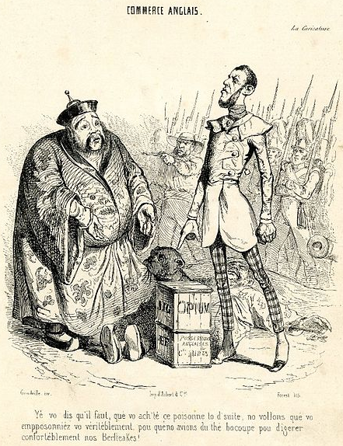
Opium was Vital!
We have established that the British needed the opium trade for their deficit. However, “China, on the other hand, was not an eager buyer of anything English.” (Fay, p. 22)
French political cartoon, 1840: Shows an Englishman ordering the emperor of China to buy opium. Another Chinese man lies dead on the ground with troops in the background. The text says: “ tell you to immediately buy this poison. We want you to poison yourself completely, because we need a lot of tea in order to digest our beefsteaks.”
Fig courtesy: https://guides.tricolib.brynmawr.edu/opium

Slide 11
Opium was Vital!
We know that the immediate beneficiaries, that is, the EIC, and later, the local Board controlling the trade between India and China, knew the importance of the Opium trade.
“Lord Macartney… revealed himself to be quite precisely informed about the quantity and value of what he called the ‘Contraband trade’ in opium” (Blue, p. 3)
The British government “Must previously have entertained that the flow of opium from Calcutta and Bombay to the Gulf of Canton and the coastal stations to its east and west would continue and grow” (Fay, p. 21)
With the fear that the Chinese would interrupt that flow.

Slide 12
So, the Main Thesis… ?
England went to war for compensation:
So, England went to war over opium, but not to “Fasten the opium habit upon the Chinese Empire.” (Fay, p. 24)
Palmerston, gunboat extraordinaire: Uses the lobby of Jardine and Co. to decide how to wage war with China. Does not read actual plea that Jardine sent.
They ignored the merchants, ignored the ban, because “She had her share.” (Fay, p. 24)

Slide 13
More on Palmerston’s government: Not the PM, still in charge, somehow… ?
Palmerston, to Parliament: Why should we help enforce the Chinese prohibition as opposed to free trade? And spend money putting gunboats opposed to our disposal of opium to Chinese consumers?
“But what, Palmerston asked, would Parliament have said had he come to it with “a large naval estimate for a number of revenue cruisers to be employed in the preventative service from the river at Canton to the Yellow Sea, for the purpose of preserving the morals of the Chinese people, who were disposed to buy what other people were disposed to sell them? (Fay, pp. 25-26)

Slide 14
Enforcement of the Ban would have led to Illicit Trade instead!
Fay argues that rather than the British government, third party providers would have met up for the shortage, thus reducing the income that they generated.
“But the ready availability of opium in places other than Bengal and the existence of abundant tonnage not under British service was sure to reverse that decline before long unless a preventative service was put down.” (Fay, p. 25)

Slide 15
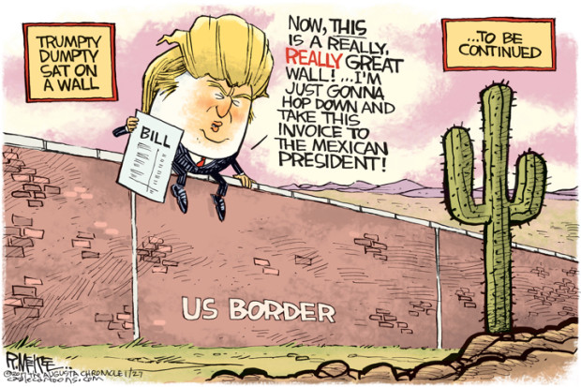
Palmerston: Do you want to pay for a police to prevent opium smuggling? I won’t!
Fig courtesy: https://www.mercurynews.com/2017/01/27/cartoons-donald-trumps-wall/

Slide 16
O Tempora, O Mores… !
The British navy was already involved in a smuggling ban: that of the Atlantic Slave Trade. Palmerston (and the Whigs) were in support of the ban.
“Slavery and slave trade were proscribed in places governed from Westminster because Englishmen came to perceive them as sinful. (Fay, p. 26)
Both are sinful, but…
Familiarity? They had a drug problem, but it was not much of a drug problem. (Fay, p. 26)
Unfamiliarity? It will always be difficult to concentrate upon drugs as powerful a current or moral disapproval as can be summoned to play upon certain other things – slavery, child labor, capital punishment.
Furthermore, they smoked it!
Notes:
Basically, These things are done to you while a drug is something you take. We have the issue of consent once more. Is it easier to ban a thing when it is obviously passive, than to ban something that you could opt to do?

Slide 17
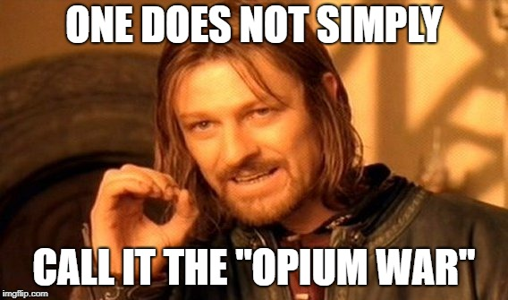
So, it was just a War then?
“England went to war to protest the arbitrary confiscation of, and recover the value of, certain goods the private property of British subjects.” (Fay, p. 27). That is the reason for war.
“Because the property in question was opium, and the injured persons men who for a part of each business day dealt in opium, it follows that England went to war over opium” (Fay, p. 24)
Fig courtesy: https://imgflip.com/
Notes:
England:
Opium was not their priority - merely associated with the war.
Their priority was the compensation and establish their version of free trade.

Slide 18
So, it was just a War then?
“That, (recovery of confiscated of private British property) in the 19th century , was a legitimate reason for war” (Fay, p. 27). Therefore, this was a just war in 19th century terms.
In the Footnotes: “It is probably safe to say that in the 19th century, though not today, a state was considered to have the right to resort to force not only to defend the state’s self but also as a measure of legitimate self-help taken in response to other injuries… injuries in response to which alternative means of self-redress prove unavailing and unsatisfactory.” (Fay, p. 31)
Notes:
England:
Opium was not their priority - merely associated with the war.
Their priority was the compensation and establish their version of free trade.

Slide 19

Important Takeaway
Fig courtesy: https://imgflip.com/

Slide 20
Takeaways - Different Views on Opium
Opium was treated as a disease and an evil.
“the wide-spreading and baneful influence of opium, when regarded simply as injurious to property, is of inferior importance; but when regarded as hurtful to the people, it demands most anxious consideration: for in the people lies the very foundation of the empire.” (“The First Clash with the West”, pg. 117)
The view above was contrasted by Frank Dikötter, i.e. self-control.
“Opium smokers, in short, could moderate their use for personal and social reasons and even cease taking it altogether without help.” (Dikötter, pg. 4)

Slide 21
Takeaways
Harsh laws on Opium usage and selling amongst the own populace.
“Whoever shall hereafter open a “furnace”, and connive with and secretly buy opium of the outside barbarians, storing it up for sale, if he be the principal, be decapitated immediately on conviction.” (“The First Clash with the West”, p. 120)
Additionally not allowed to grow opium on own land.
Not only was it a matter of drug trade, but also a matter of opium being a social illness.
Lack of cooperation by the British.
“... failure to extract a permanent guarantee of no further involvement in the trade, ... a bellicose last-minute embargo on all British trade and provisioning.” (Polachek, 1991, p. 151)

Slide 22
Takeaways
Palmerston generally being intolerable towards the Chinese.
They acted out in violence, but at the same time, they cannot punished with violence.
“... certain officers, acting under the Authority of The Emperor of China, have committed violent outrages against the British Residents at Canton, who were living peaceably in that City... Her Majesty cannot permit that Her Subjects residing abroad should be treated with violence.” (“The First Clash with the West”, p. 124)
Blockade of Chinese ports, as well as going up a short distance to threaten the Imperial Cabinet. Due to this expedition, the British Government expected them to pay for the cost of the expedition itself.
“... the necessity for sending this Expedition to the Coast of China having been occasioned by the violent and unjustifiable acts of the Chinese Authorities, the British Government expects and demands, that the expenses incurred thereby shall be repaid to Great Britain by the Government of China.” (“The First Clash with the West”, p. 126)

Slide 23
References
Fay, P. W. (1977). Was the Opium War of 1840-42 a Just War. In Late Imperial China, pp 17-31.
Blue, G. (2000). Opium for China: The British Connection. In Opium Regimes: China, Britain, and Japan, 1839-1952. Berkeley: University of California Press pp. 31-54.
The First Clash with the West. Cheng P., & Lestz M. (Eds). In The Search for Modern China: A Documentary Collection, pp. 110-119.
Dikötter, F. (2003). ‘Patient Zero’: China and the Myth of the ‘Opium Plague’. In Inaugural Lecture Series: School of Oriental and African Studies. London (22 pp.)
Polachek, J. (1991). In The Inner Opium War. Harvard, pp. 1-16; 137-203; 273-287.

